Slide 1
OpenCV環境設置
2023S電腦圖學

Slide 2
Source
環境設定完整教學
https://reurl.cc/r5QAnr

Slide 3
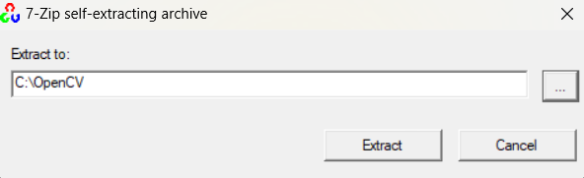
OpenCV – 2.4.13.6
https://reurl.cc/gD032X
下載後直接執行.exe檔案，並選擇安裝路徑
記得將安裝路徑記起來等等設定目錄會用到

Slide 4
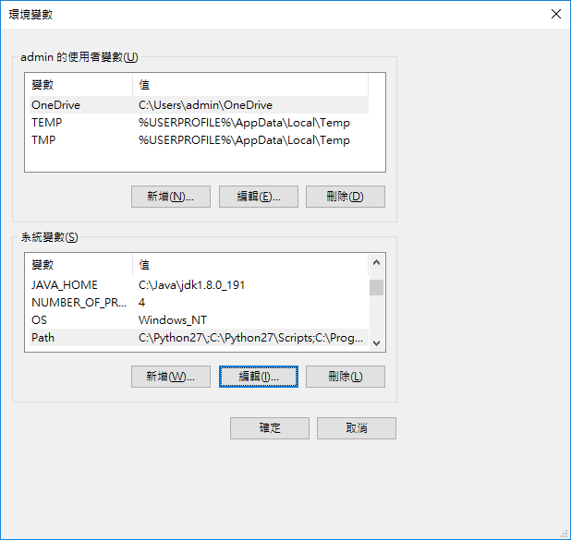
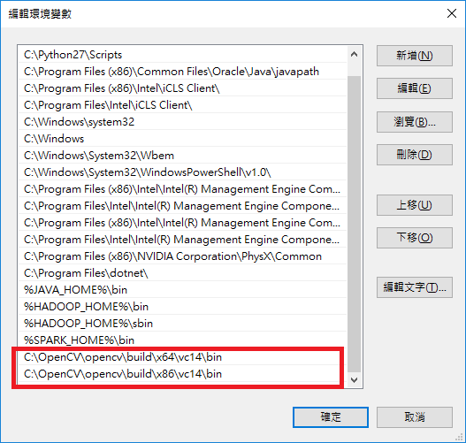
設定系統環境變數

Slide 5
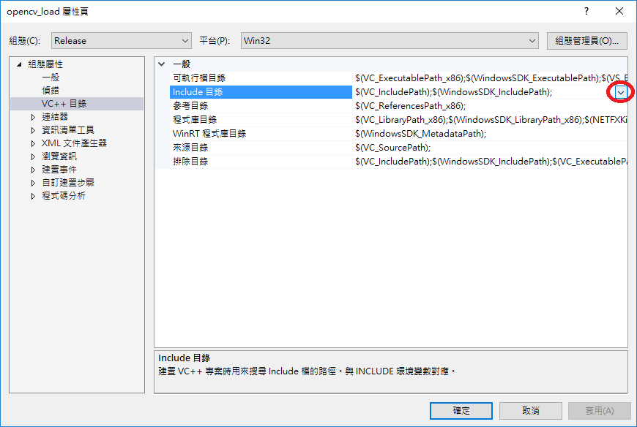
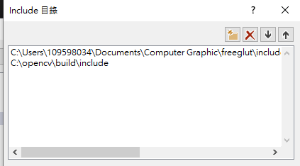
Visual Studio – Include目錄(include)

Slide 6
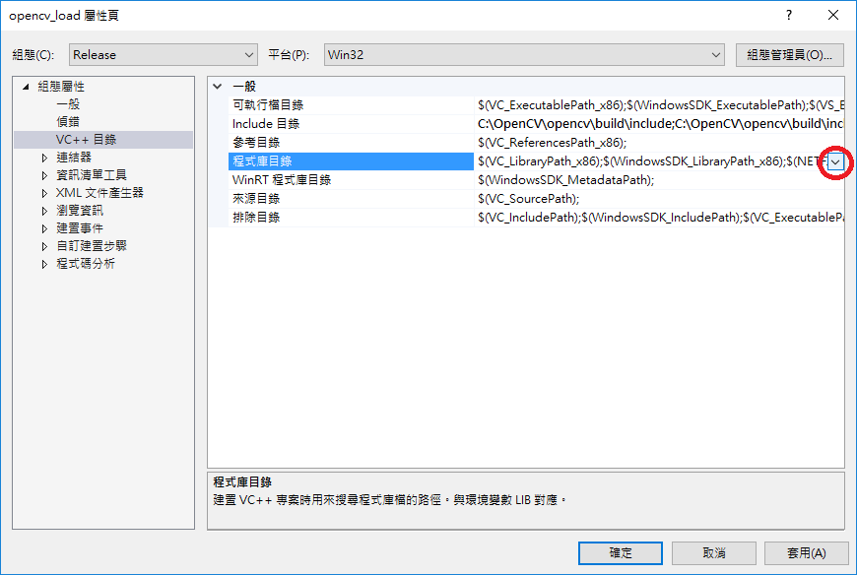
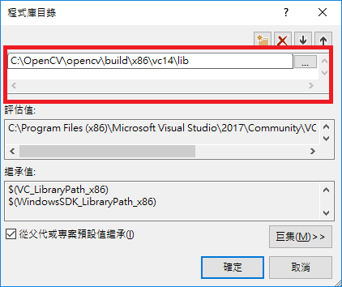
Visual Studio – 程式庫目錄(lib)

Slide 7

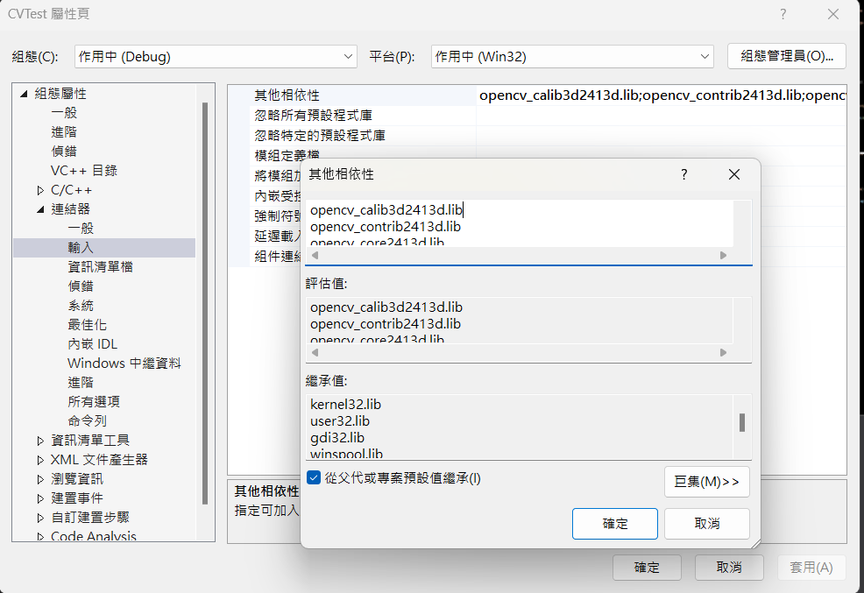
Visual Studio – 其他相依性
opencv_calib3d2413d.lib
opencv_contrib2413d.lib
opencv_core2413d.lib
opencv_features2d2413d.lib
opencv_flann2413d.lib
opencv_gpu2413d.lib
opencv_highgui2413d.lib
opencv_imgproc2413d.lib
opencv_legacy2413d.lib
opencv_ml2413d.lib
opencv_nonfree2413d.lib
opencv_objdetect2413d.lib
opencv_ocl2413d.lib
opencv_photo2413d.lib
opencv_stitching2413d.lib
opencv_superres2413d.lib
opencv_ts2413d.lib
opencv_video2413d.lib
opencv_videostab2413d.lib
左邊的文字直接複製貼到連結器→輸入→其他相依性中
你也可以從下面的備忘錄複製
Notes:
opencv_calib3d2413d.lib
opencv_contrib2413d.lib
opencv_core2413d.lib
opencv_features2d2413d.lib
opencv_flann2413d.lib
opencv_gpu2413d.lib
opencv_highgui2413d.lib
opencv_imgproc2413d.lib
opencv_legacy2413d.lib
opencv_ml2413d.lib
opencv_nonfree2413d.lib
opencv_objdetect2413d.lib
opencv_ocl2413d.lib
opencv_photo2413d.lib
opencv_stitching2413d.lib
opencv_superres2413d.lib
opencv_ts2413d.lib
opencv_video2413d.lib
opencv_videostab2413d.lib

Slide 8
測試
#include <iostream>
#include <opencv2/core/core.hpp>
#include <opencv2/highgui/highgui.hpp>
using namespace std;
using namespace cv;
int main(int argc, char** argv){
String ImgPath = "D:\\Lena.png";
Mat image = imread(ImgPath, CV_LOAD_IMAGE_COLOR);
if (!image.data){
cout << "Can not load the image!" << std::endl;
return -1;
}
namedWindow("Display Window", CV_WINDOW_NORMAL);
imshow("Display Window", image);
waitKey(0);
return 0;
}
新增一個.cpp並丟入來源檔案中
下面備忘錄可以直接複製程式碼，你也可以複製左邊的
記得把圖片路徑改成你自己的圖片，如果程式有成功執行並且有看到自己設定的圖片就代表OpenCV環境已經成功建好了
Notes:
#include <iostream>
#include <opencv2/core/core.hpp>
#include <opencv2/highgui/highgui.hpp>
using namespace std;
using namespace cv;
int main(int argc, char** argv){
String ImgPath = "D:\\Lena.png";
Mat image = imread(ImgPath, CV_LOAD_IMAGE_COLOR);
if (!image.data){
cout << "Can not load the image!" << std::endl;
return -1;
}
namedWindow("Display Window", CV_WINDOW_NORMAL);
imshow("Display Window", image);
waitKey(0);
return 0;
}

Slide 9
結合openGL和openCV套材質到平面上

Slide 10
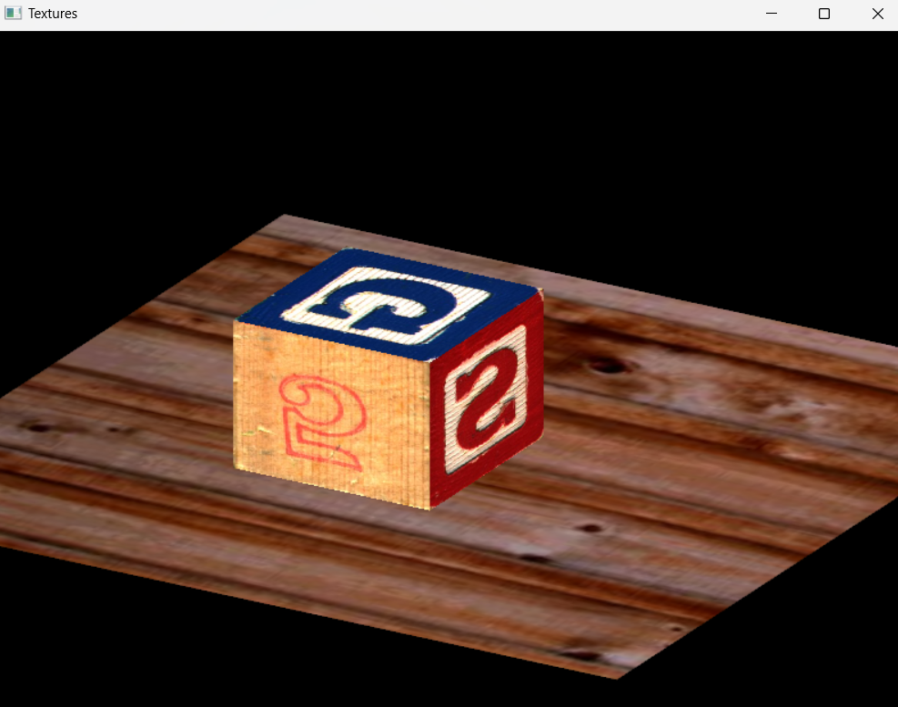
將圖片轉換成材質

Slide 11
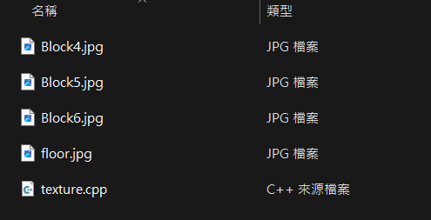
下載OpenCVTexture.zip
裡面有四張圖和一份texture.cpp檔案
把圖片放到指定的路徑並且修改.cpp中的路徑才能看到圖片

Slide 12
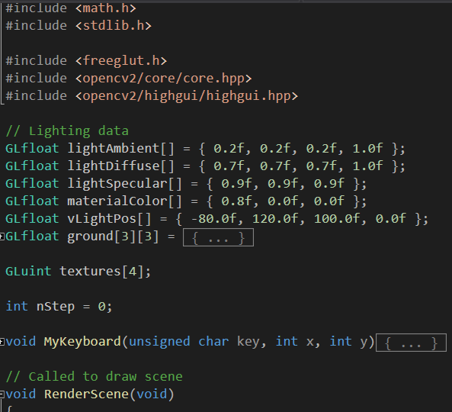
先宣告一個全域變數陣列

Slide 13
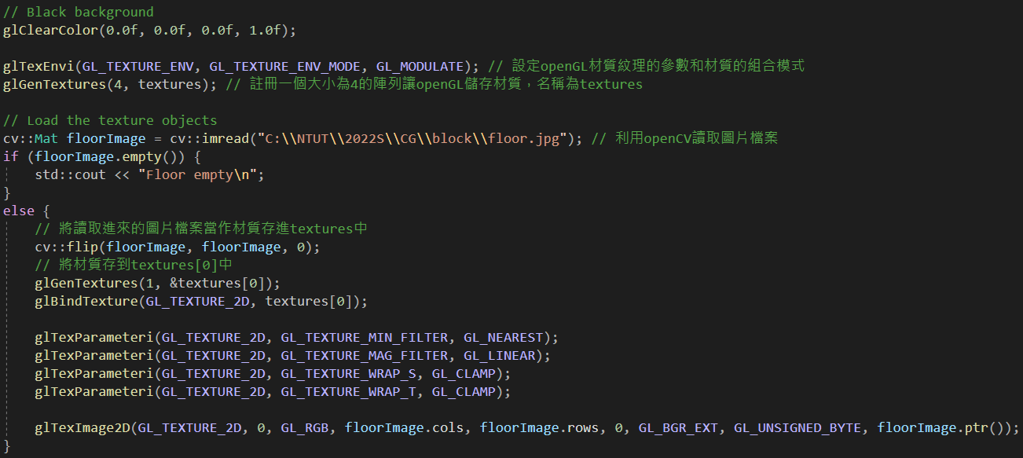
註冊材質的方法

Slide 14
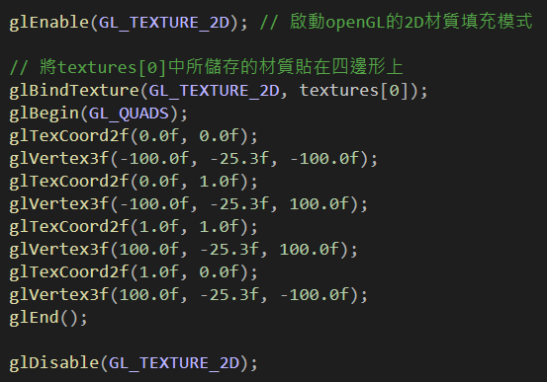
使用註冊好的材質

Slide 15
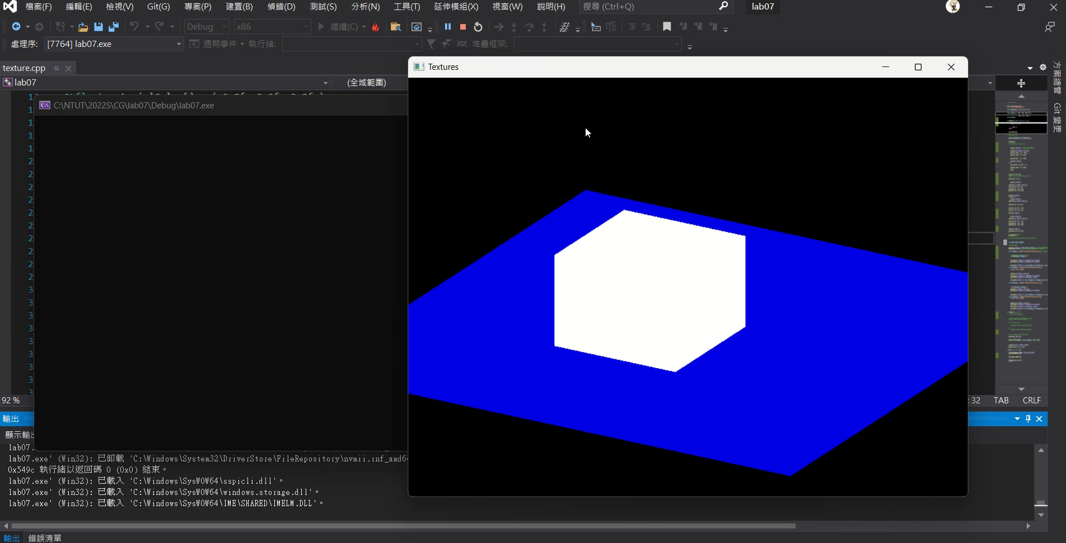
按R可以看到材質一個一個貼上去

